Slide 1




Air Quality Monitoring in Bosnia and Herzegovina: Current Challenges and Future Prospects
Prof. dr. Sabina Žero, University of Sarajevo – Faculty of Science
Prof. dr. Emina Ramić, University of Sarajevo – Faculty of Pharmacy
NextAIRE Summer School Sarajevo
Sarajevo, UNSA-PMF, 07.-08.09.2026.

Slide 2
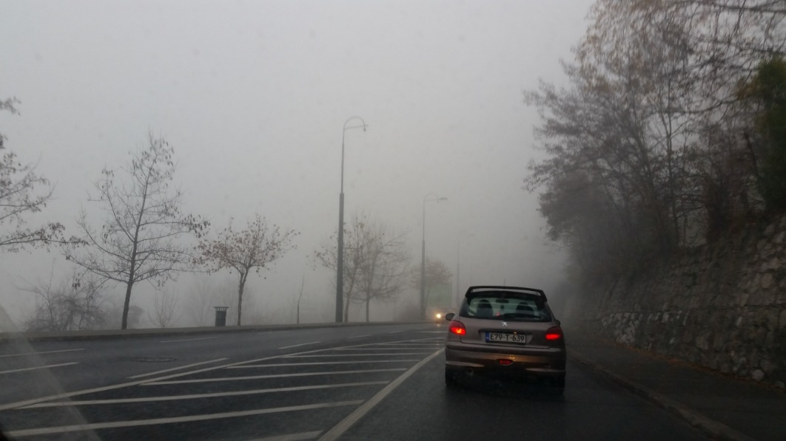
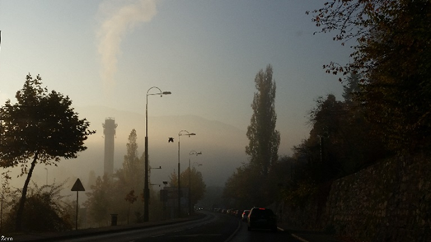
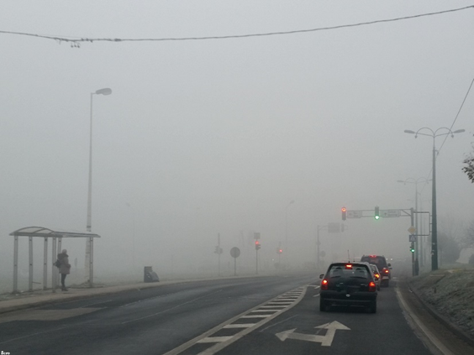
Air Pollution in Sarajevo
Alipašina ulica, Sarajevo, 17 dec 2015, period 7.00-8.00 hours

Slide 3
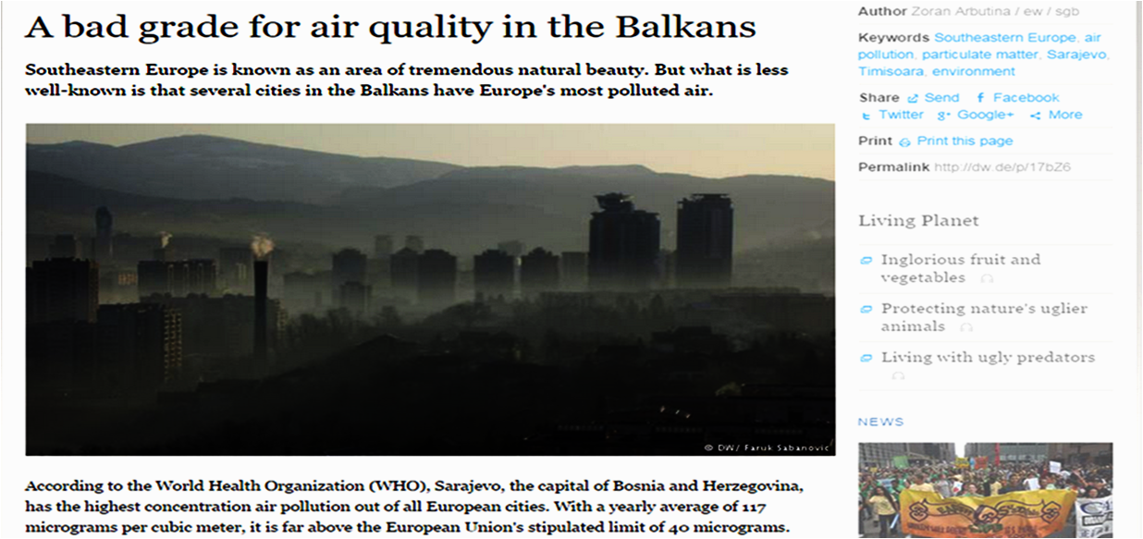
Why the Air of Sarajevo?
Sarajevo's air is polluted air during the winter and is expected to be favorable as a research medium for particulate matter content

Slide 4
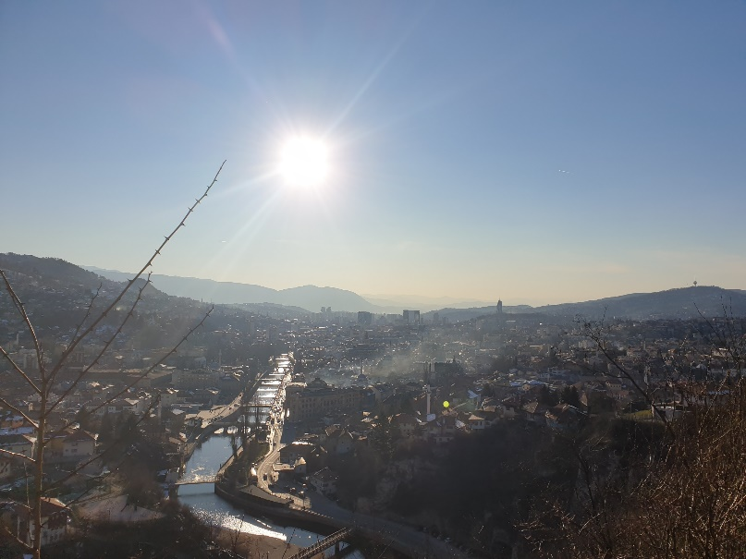
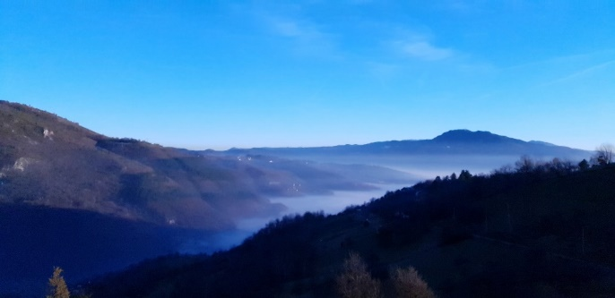

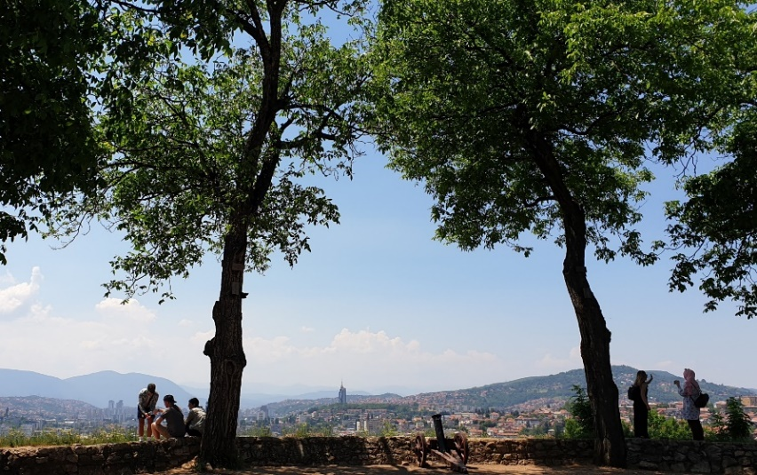
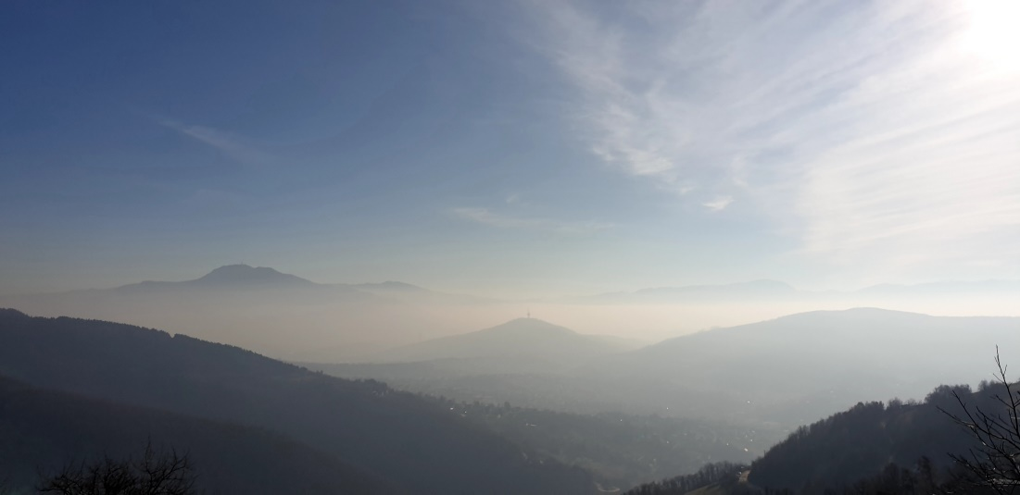
Sarajevo Air Quality

Slide 5
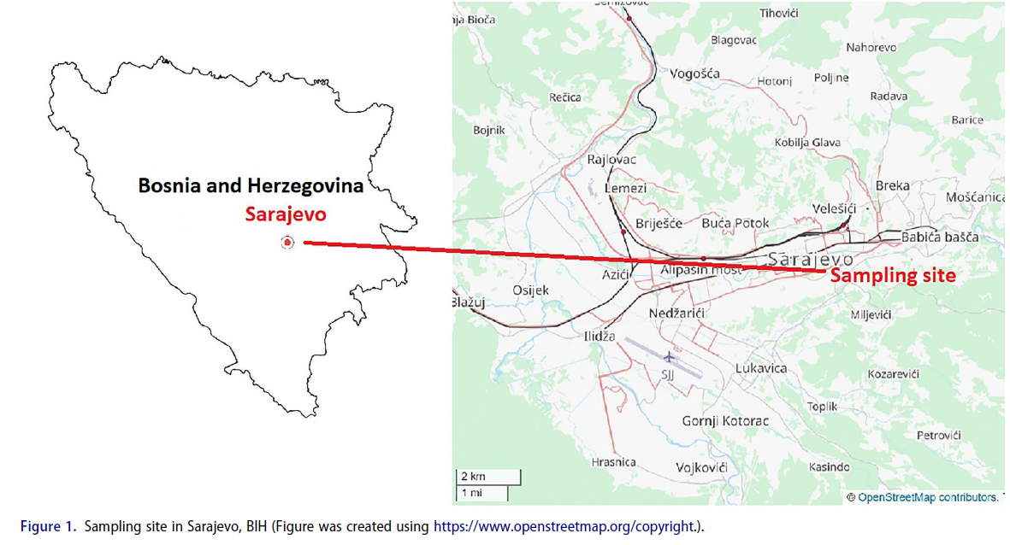
Sampling of PM10

Slide 6
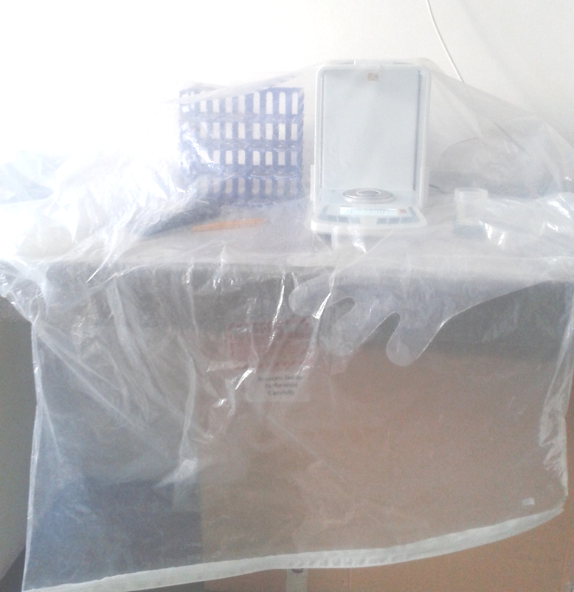
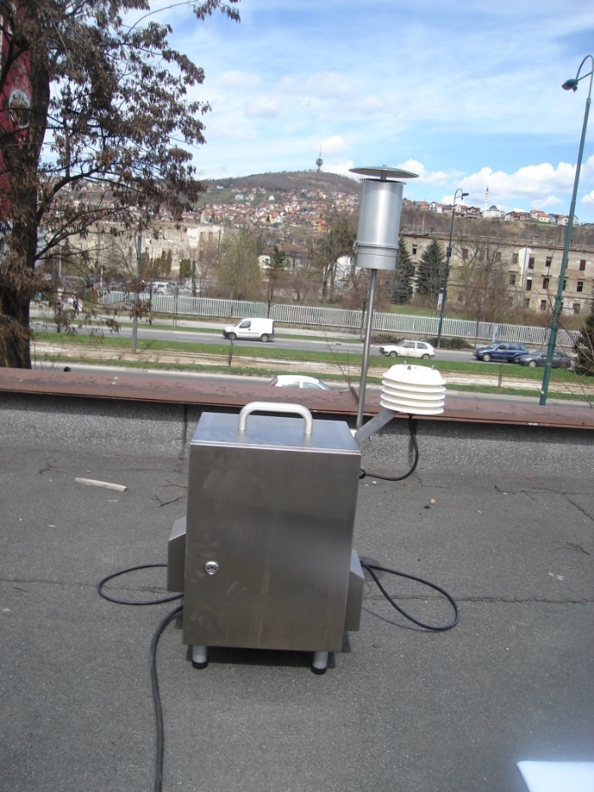
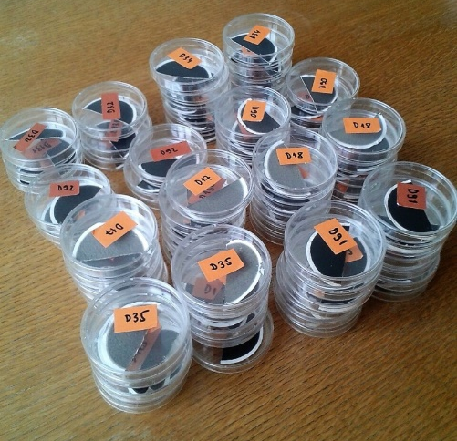
Sampling of PM10
Sven Leckel MVS6
Quartz Filters 47 mm Ø – Whatman Grade QMA

Slide 7
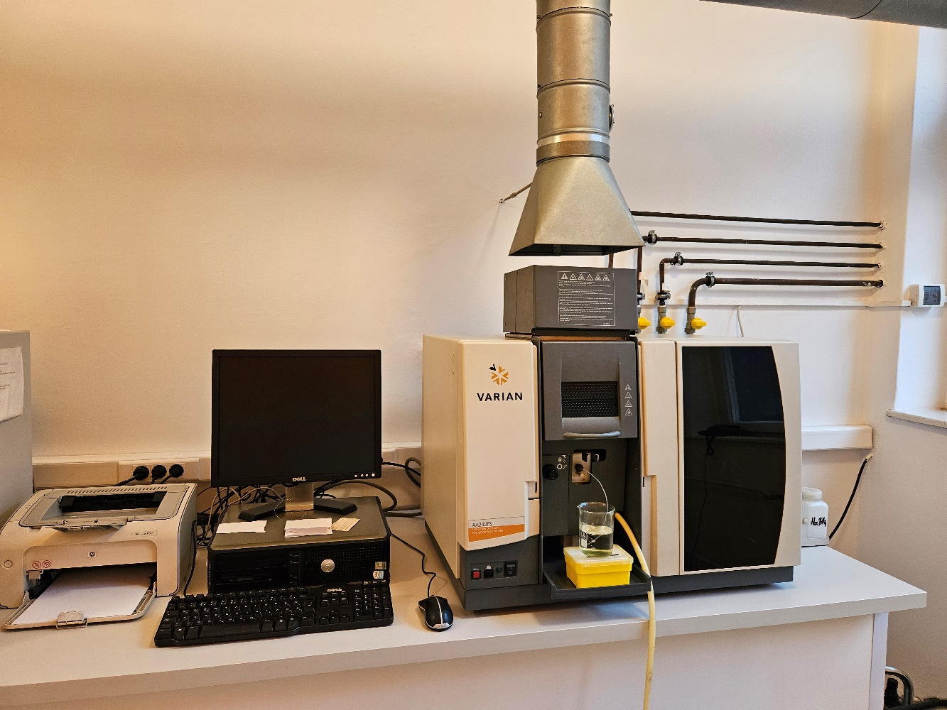
Filter analysis
Acid digestion
Atomic absorption spectrometry: FAAS, GFAAS
Analytical quality control – CRM

Slide 8
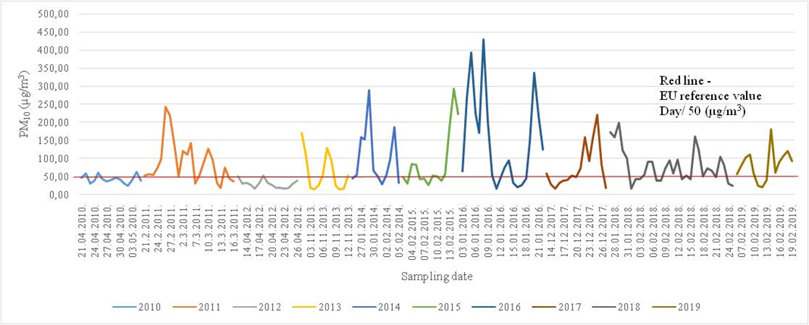
PM10 concentration trend in Sarajevo
Air quality in Sarajevo is mostly affected by emission of pollutants from industrial facilities, households and traffic. The most common causes of pollutants from households are: individual heating of households by solid fuels in inadequate burning devices causing heat losses, room furnaces and boilers with small energetic efficiency.

Slide 9
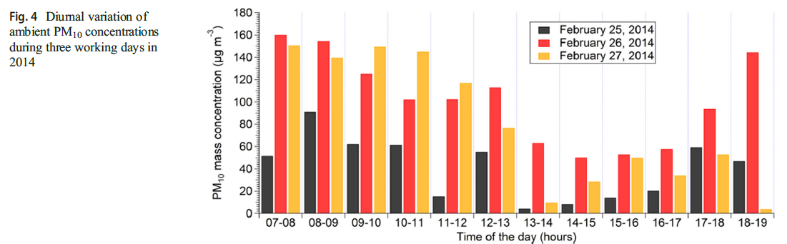
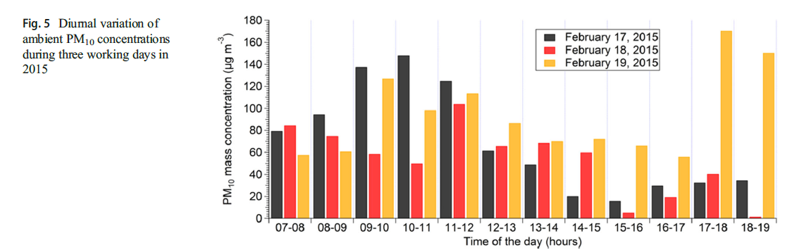
PM10 concentration trend in Sarajevo

Slide 10
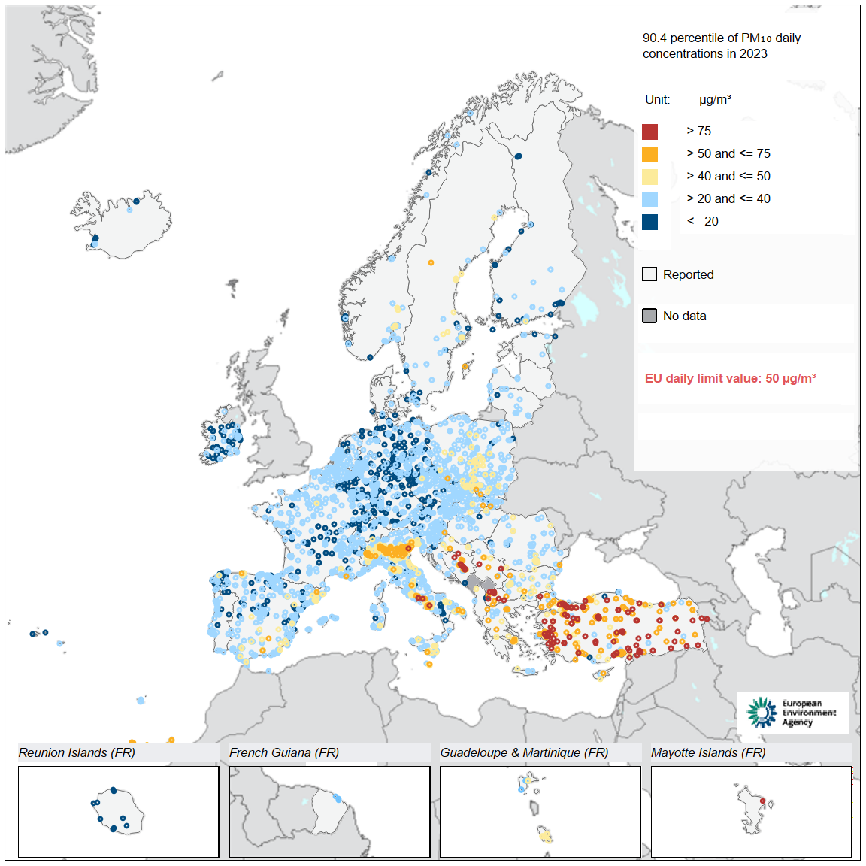
Concentrations of PM₁₀ in 2023 in relation to the EU daily limit value
Directive (EU) 2024/2881 of the European Parliament and of the Council of 23 October 2024 on ambient air quality and cleaner air for Europe (recast) aims to
Define common methods to monitor, assess and inform on ambient air quality in the EU, including pollutants of emerging concern;
Establish objectives for ambient air quality through a regular review mechanism to avoid, prevent or reduce harmful effects on human health and the environment;
Guide the assessment of air quality supported by a representative high-quality monitoring network, with more than 4,000 air quality monitoring stations across the EU and an enhanced use of air quality modelling;
Exchange reliable, objective and comparable information on air quality, which includes informing the wider public about possible health impacts.
Develop air quality plans that are effective in ending and preventing exceedances of EU standards.

Slide 11
Bioaccssesability of metals in PM10 fraction of particulate matter in urban and rural Sarajevo
Bioaccssesability is expressed as a percentage of the content of the elements obtained by batch extraction simulating body gastric juice relative to the total metal content of PM10
 | Bioaccssesability of metals (%)
 | Cd | Cr | Cu | Mn | Ni | Pb | V | Zn | Fe
Urban location | 41 | 11 | 55 | 33 | 33 | 53 | 29 | 25 | 15
Rural Location | 36 | 26 | 54 | 31 | 34 | 58 | 28 | 12 | 8

Slide 12
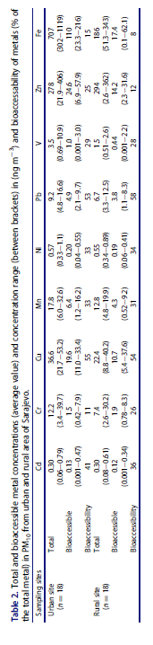
Bioaccssesability of metals in PM10 fraction of particulate matter in urban and rural Sarajevo

Slide 13
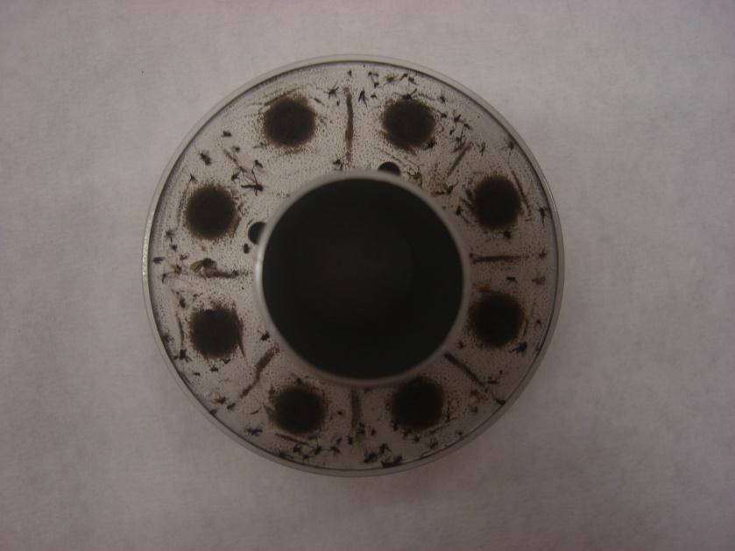
Enrichment factor
In order to assess the potential source of PM10 in the Sarajevo area, the calculation of the enrichment factor (EF) was performed
Fe was selected as the reference element
EF
Location/metal | Mn | Ni | Cd | Pb | Zn | Cu | Cr
Urban | 1.1 | 0.3 | 2.1 | 7.0 | 141 | 70.6 | 5.9
Rural | 2.1 | 0.7 | 10.1 | 38.6 | 1390 | 275 | 10.2
In order to evaluate the source of PM10 in the Sarajevo area, an enrichment factor (EF) was calculated. When EF is close to one, soil is considered to be the dominant source of metal in the air (Dai et al., 2015), while EF> 5 indicates that much of the element can be attributed to anthropogenic or non-soil sources (Lee and Hieu , 2011).

Slide 14
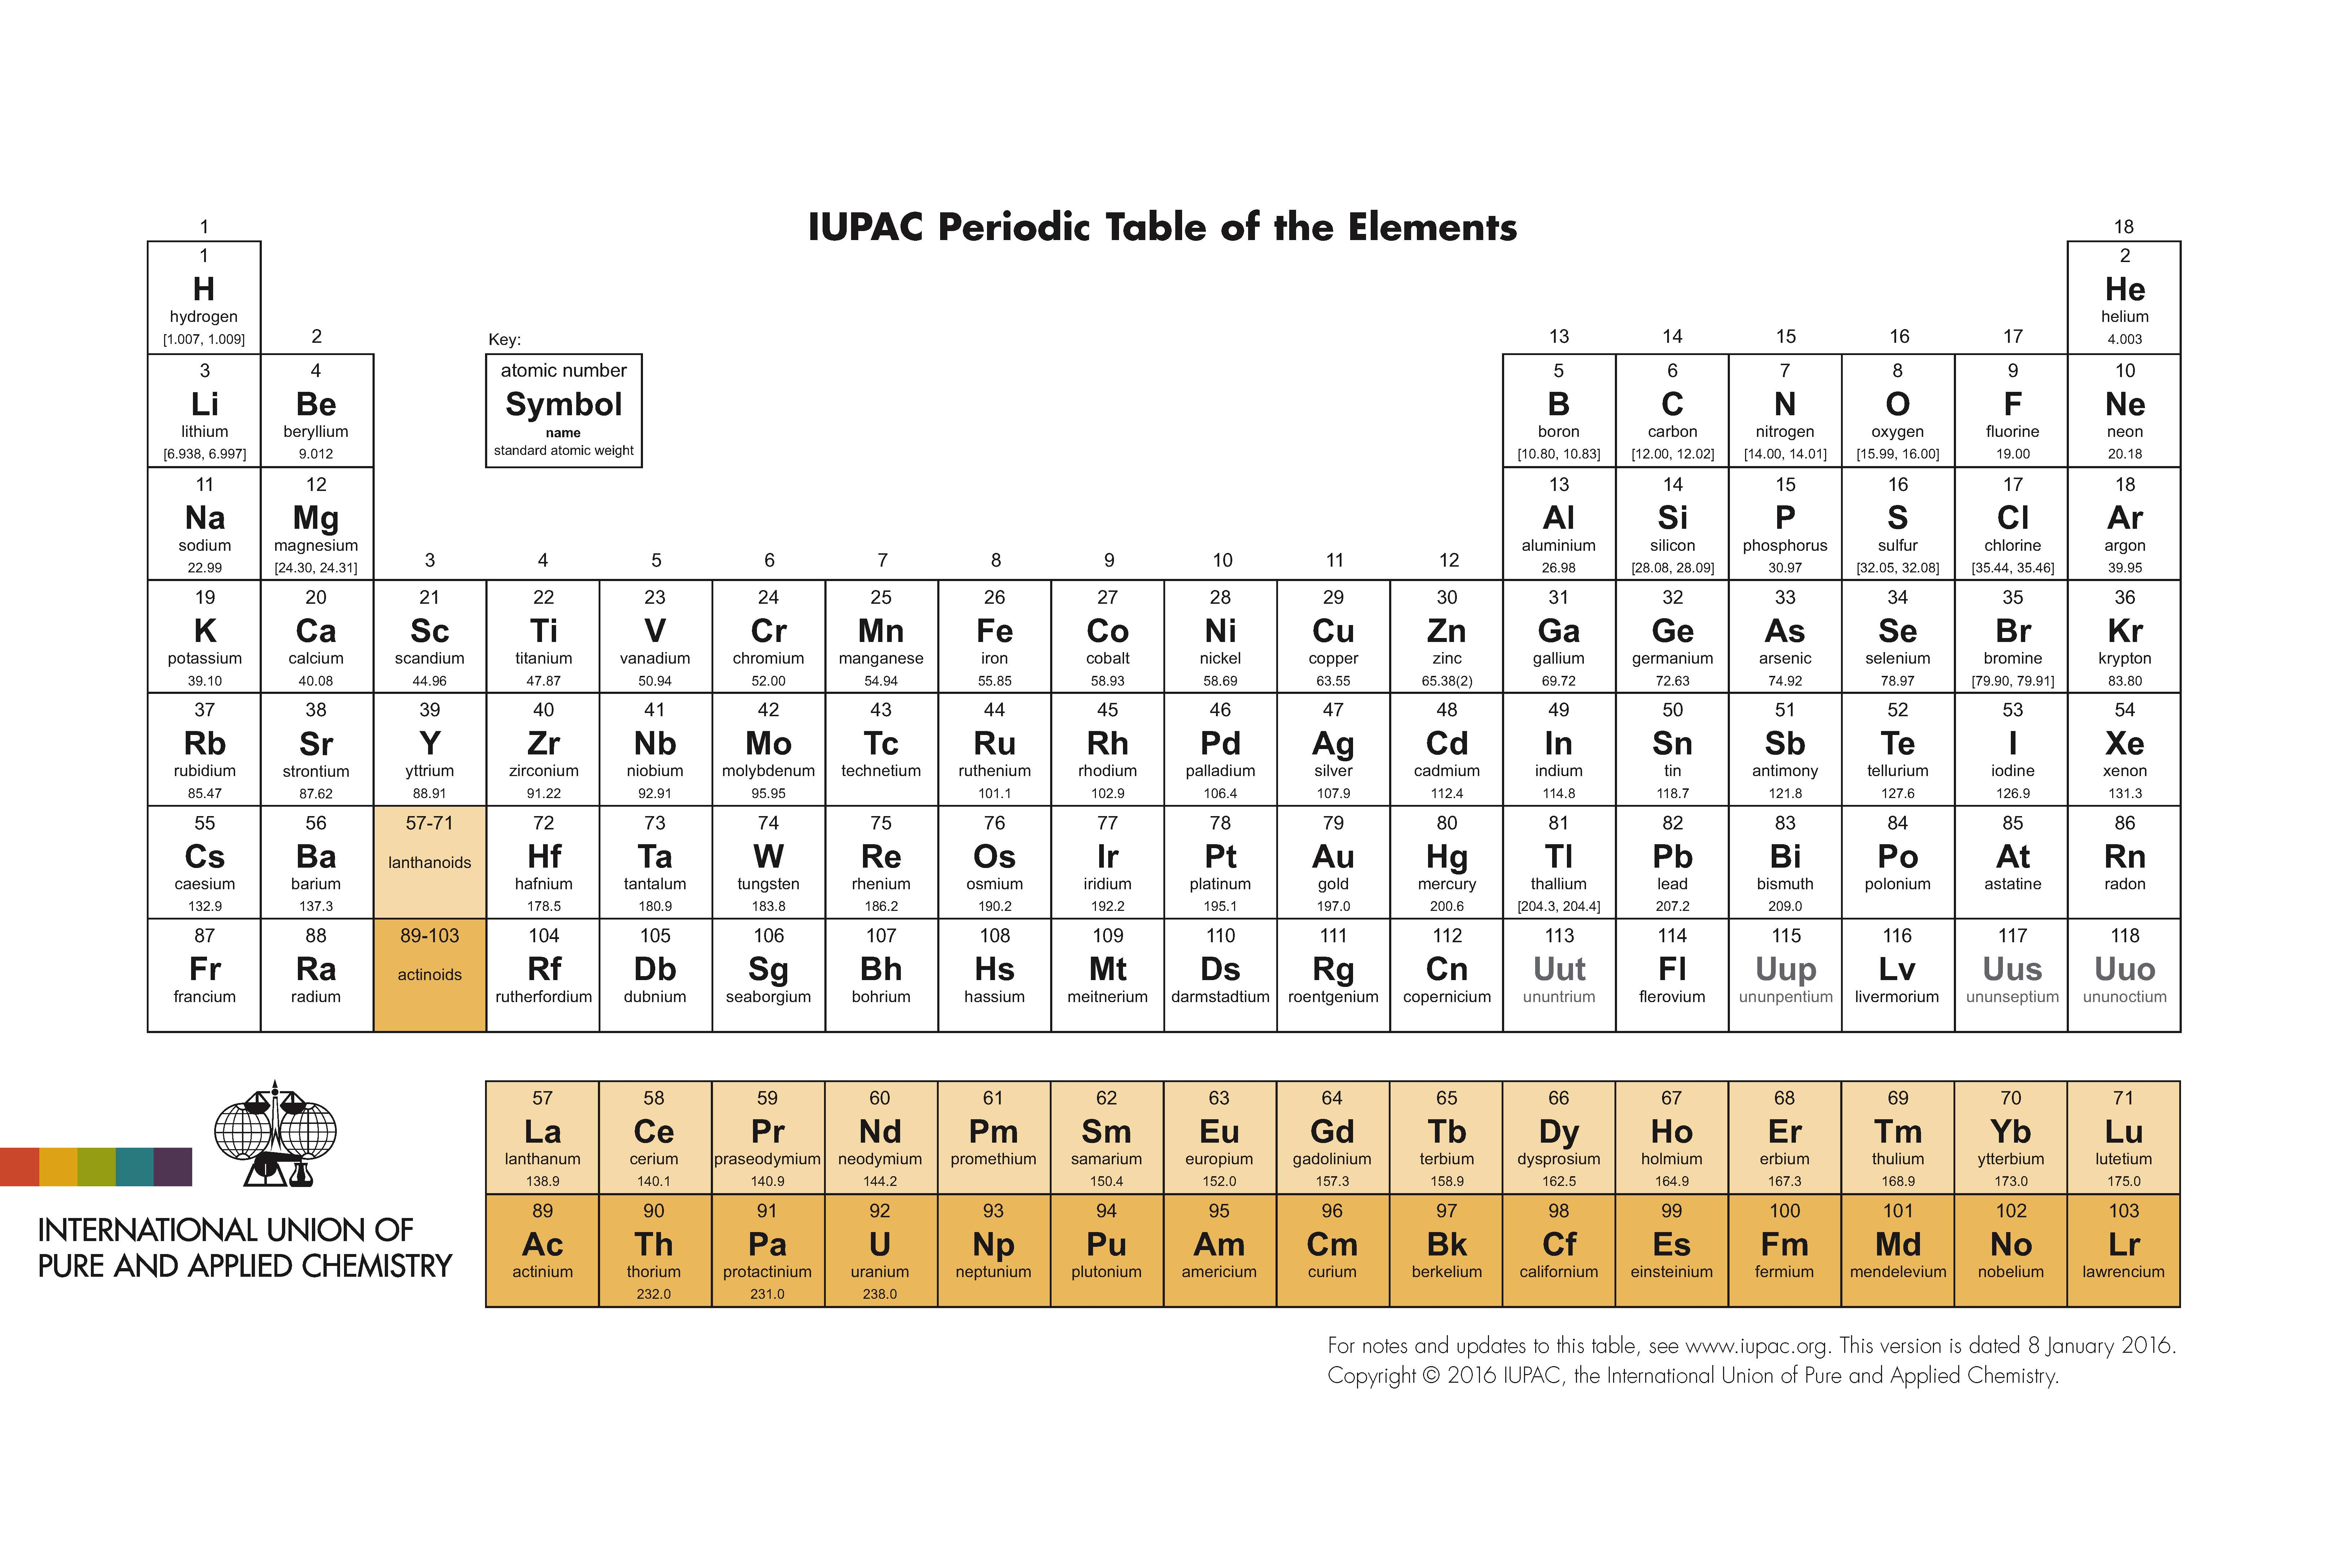
Metals in PM10
The higher values of the examined metals were generally higher in samples from location near traffic road with higher density, or in urban than rural areas.
Based on the obtained results it can be concluded that the air in the Sarajevo area is relatively loaded with heavy metals.
Further analysis is needed.

Slide 15
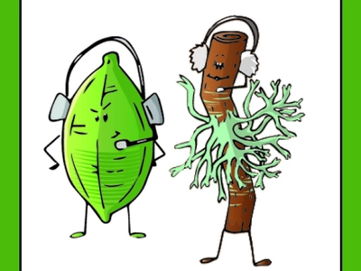
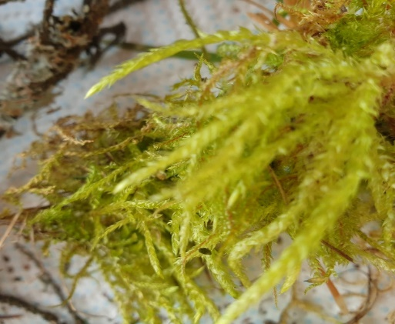
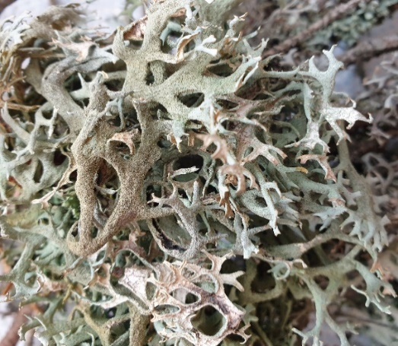
??
What can the biota tell us about the environment and its response to natural stress?
All species (or species assemblages) tolerate a limited range of chemical, physical, and biological conditions, which we can use to evaluate environmental quality.
Despite many technological advances, we find ourselves turning to the biota of natural ecosystems to tell us the story of the world.

Slide 16
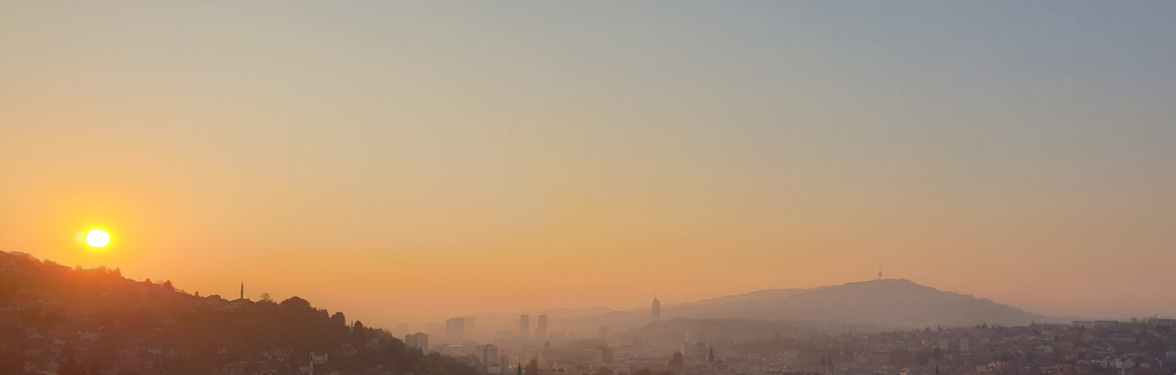
What we can do to prevent further pollution and climate change?

Slide 17
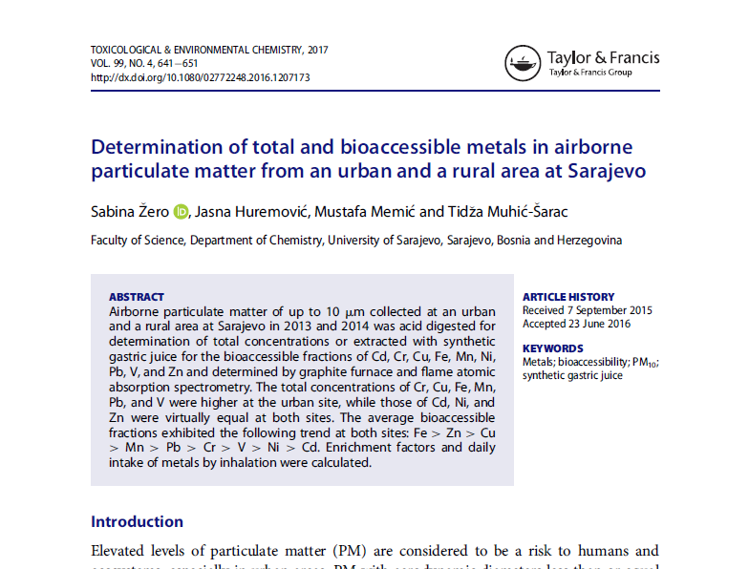
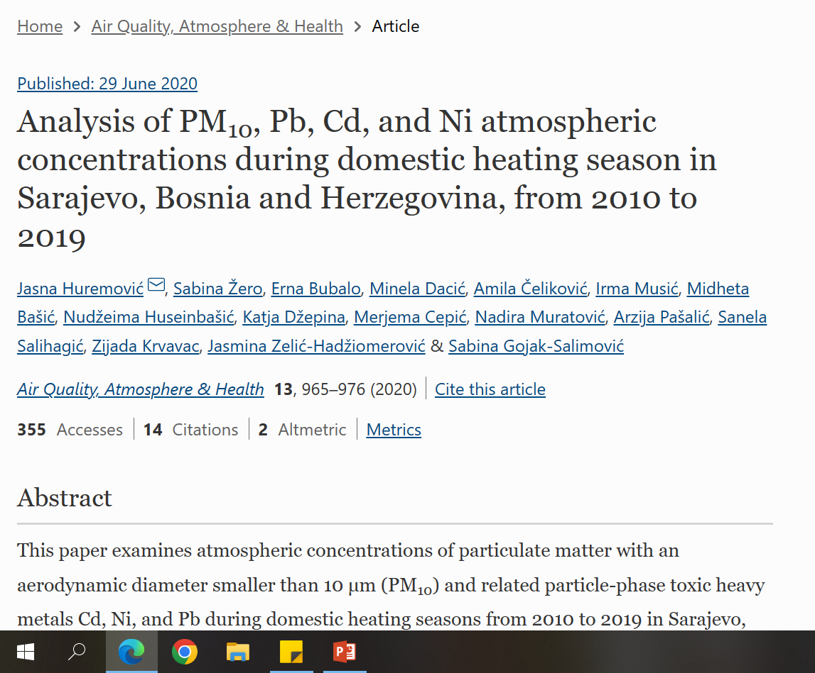
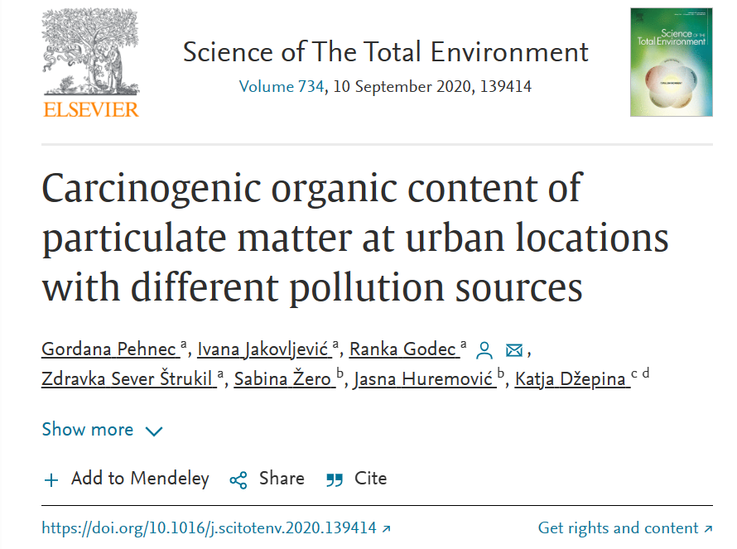
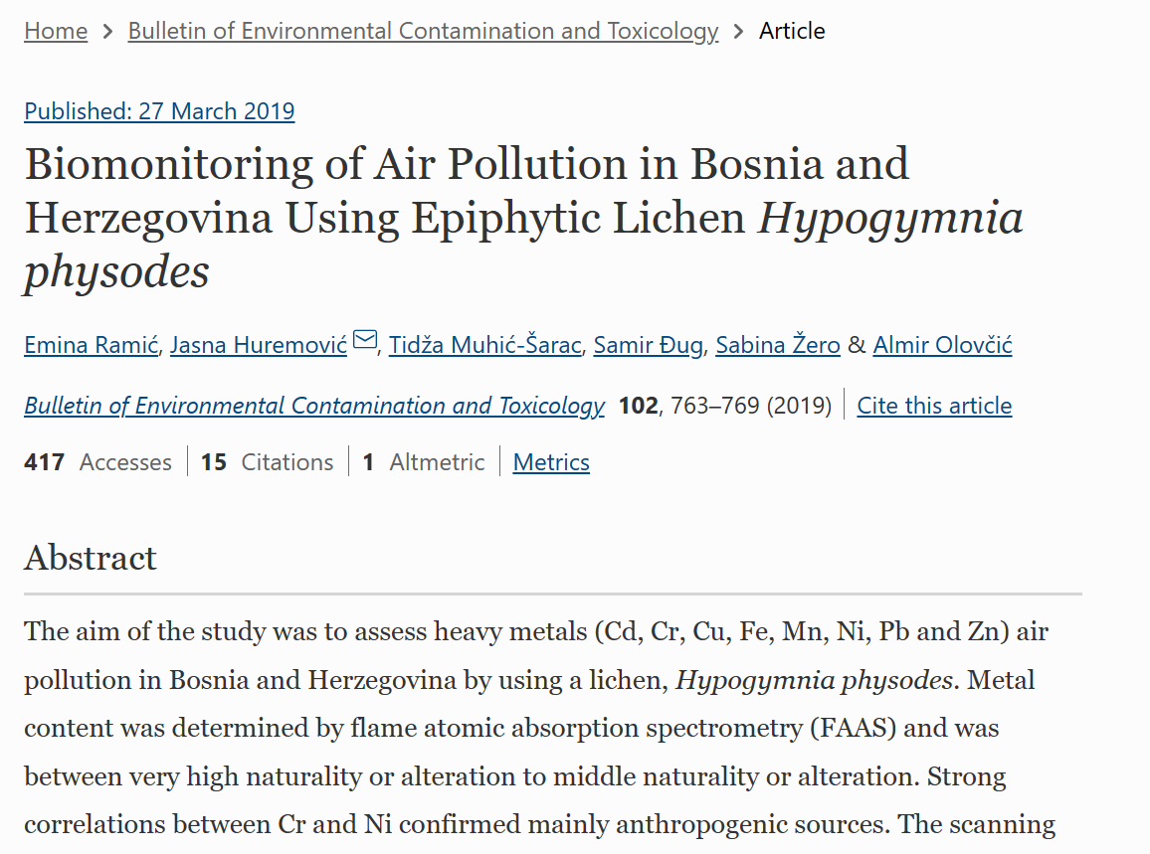
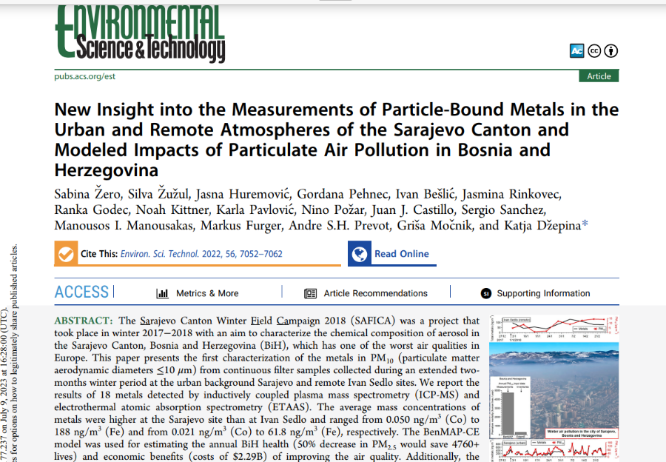
Sarajevo Air Quality

Slide 18
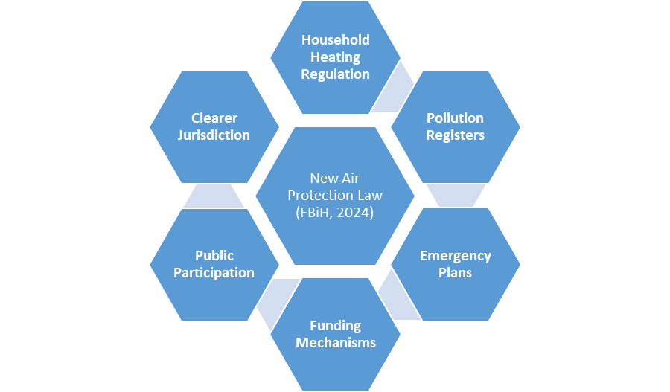
New Air Protection Law
ZAKON O ZAŠTITI ZRAKA
The law is designed to harmonize with EU environmental legislation. It also integrates climate change mitigation and adaptation strategies.
SLUŽBENE NOVINE FEDERACIJE BiH Broj 72, 13. 9. 2024.

Slide 19

Thank you!

